Slide 1

Binary Search
Hung Yen Universtiy of Technology and Education
Faculty of Information and Technology
Devide and Conquer
Tun Do Thanh
Lee Min Thon
Nguyen Zan Wang
Presenter

Slide 2
Content
What is Divide and Conquer?
Binary Search
Applicatoins and Comparisions

Slide 3

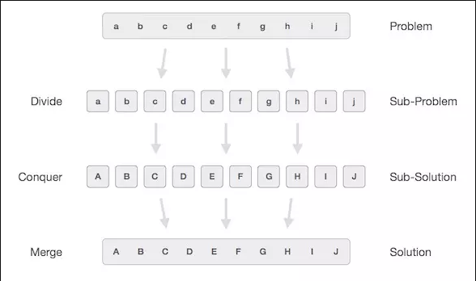
Devide and Conquer
Divide and conquer is a method applied to problems that can be solved by breaking down subproblems from solving these subproblems. Then the solutions of the sub-problems are aggregated into the solution of the problem

Slide 4
Implementation steps
Step 1: Devide/Split
At this steep, the original problem will be devided into subproblems until ist can no longer be broken down. The type subproblems become a small step in solving the big problem
Step 2: Conquer/ Solve subproblems
Find a solution to a specific subproblem
Step 3: Combine the solutions to derive the solution
Once you’ve solved the small problem, requeat th steps and combine the solutions to deriv the desired result

Slide 5
Binary Search
Binary search is an algorithm used to find an element in a sorted list
Binary search begins by comparing an element in the middle of the array with the target value. If the target value matches the element, its position in the array is returned. If the target value is less than the element, the search continues in the lower half of the array. If the target value is greater than the element, the search continues in the upper half of the array. By doing this, the algorithm eliminates the half in which the target value cannot lie in each iteration.

Slide 6
Procedure
Given an array A of n elements with values or records A0,A1,A2,…,An-1 sorted such that A0<=A1<=A2<=…<=An-1 and target value T
Set L to 0 and R to n-1
If L>R, the search terminates as unsuccessful
Set m(the position of the middle element) to the floor of (L+R)/2, which is the greates inteegere les than or equal to (L+R)/2
If Am<T, set L to m+1 and go to step 2
If Am>T, set R to m-1 and go to step 2
Now Am = T, the search is done, return m

Slide 7
Perfomance
Best case when x = arr[middle]
➔ Tbest(n) = O(1)
Worse case
T(n) = 1 + T(n/2) with n>=2 và T(1) = 0
T(n) = 1.T(n/2)+1.n^0
T(n) = O(lg(n))

Slide 8
Visualization for best case

Slide 9
Visualization for normal case

Slide 10
Visualization for worse case

